Slide 1
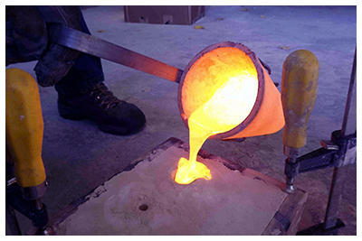
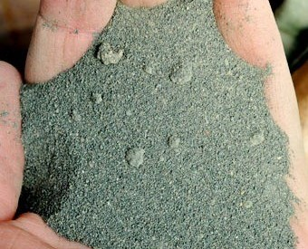
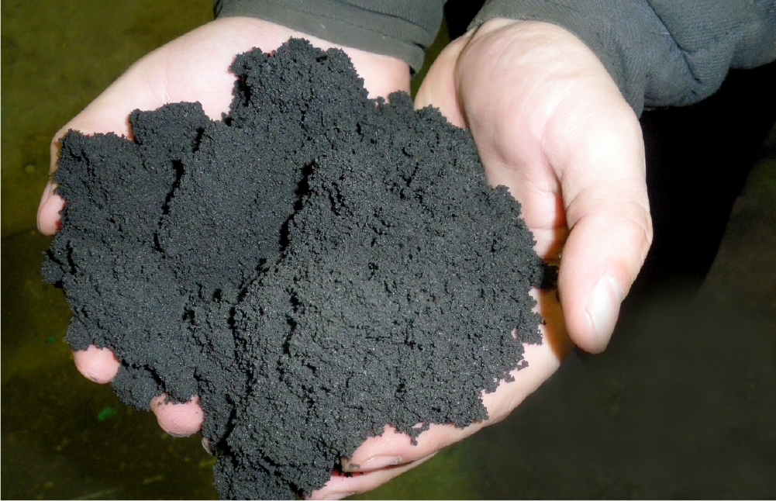
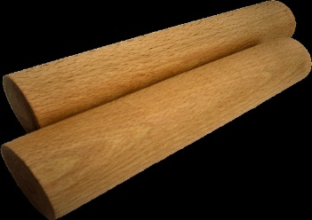
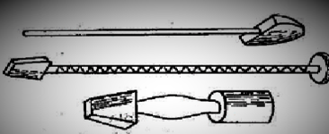


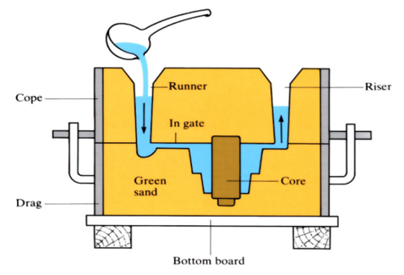
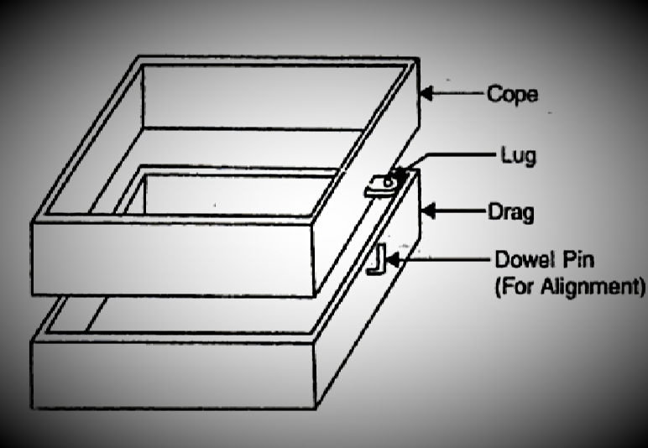
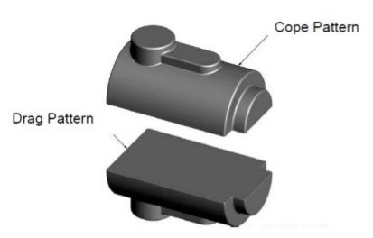
FOUNDRY
TOOLS AND MATERIALS
POURING THE MOLTEN METAL FOR CASTING
PARTING SAND
GREEN SAND
SPRUE PIN
RAMMERS
STRIKEOFF BAR
VENT WIRE
SECTIONAL VIEW OF A CASTING MOULD
COPE AND DRAG
COPE AND DRAG PATTERN

